Slide 1
Text based book classification
Aaron Kohn
Notes:
Read title and name

Slide 2

INTRODUCTION
Categorize books using the actual text.
Predict book name based on samples of text.
Predict author based off text samples.
Notes:
Point of project categorize books
This project limited to name and author

Slide 3
The data has been collected from Project Gutenberg and the following features extracted. Name Author Length and 10 Text samples
Notes:
The Gutenberg project available text lacks labels for categorization
Names of columns explained

Slide 4
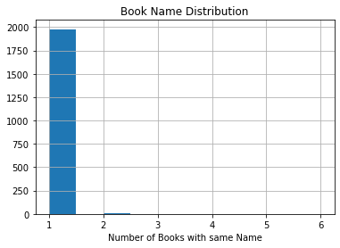
Notes:
Most book names appear only once
Very limited twice only one 4 and one 6
This is good as the point is to predict the book multiple with same name causes ….

Slide 5
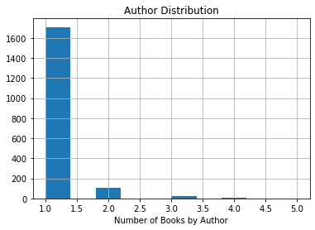
Notes:
Authors mostly appear only once.
But there are some appearing multiple times
This helps see effectiveness across books

Slide 6
Steps
10 samples for each book
Text cleaned and tokenized
Tfidf vectorization applied Unigram Multigram 1-5
Keras Neural Network for classification
Notes:
Explain steps taken

Slide 7
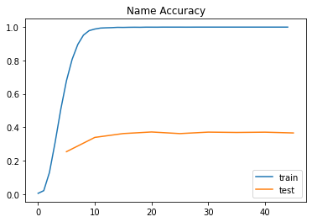
Results for Four Hundred Word Samples
Notes:
Explain accuracy with best at epoch and score35: 0.3728530932132733

Slide 8
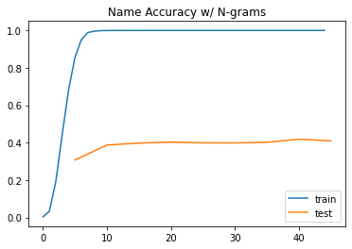
Results for Four Hundred Word Samples
Notes:
Explain accuracy with best at epoch and score 25: 0.4432216108054027

Slide 9
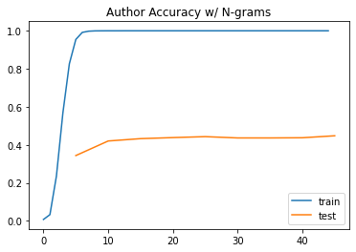
Results for Four Hundred Word Samples
Notes:
Explain accuracy with best at epoch and score 20: 0.40286810071702517

Slide 10
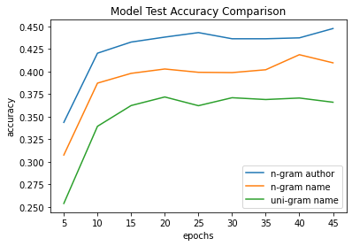
Results for Four Hundred Word Samples
Notes:
Comparison of models, best performance for author all not very high
Important to note the amount of possible categories in prediction class

Slide 11
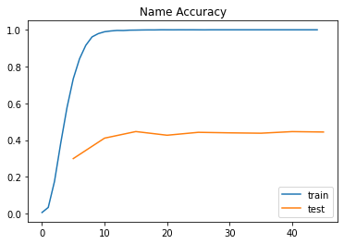
Results for 550 Word Samples
Notes:
Explain accuracy with best at epoch and score 15: 0.44666666666666666

Slide 12
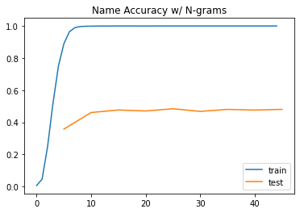
Results for 550 Word Samples
Notes:
Explain accuracy with best at epoch and score 25: 0.4845,

Slide 13
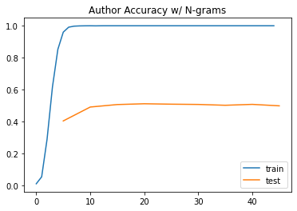
Results for 550 Word Samples
Notes:
Explain accuracy with best at epoch and score 20: 0.5108333333333334

Slide 14
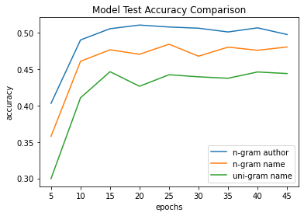
Results for 550 Word Samples
Notes:
Comparison of models, best performance for author all not very high
Important to note the amount of possible categories in prediction class
Note improved performance across all models for more words

Slide 15
results
Uni-gram Name = 54.5%
Multi-gram Name = 52.3%
Multi-gram Author = 51.6%
Notes:
Here are the results for the selected epochs on the test data set
Interesting that the model with lower performance outperforms other models

Slide 16
Recommendations
Determine predictive category
Determine optimal sample size
Create user-based categories
Notes:
For future study more testing needed to determine optimal sample size depends on book size
Find lables available for categorizing data
Create categories or find similarities based on user preforance

Slide 17
Questions
Are there specific authors harder to predict than others? No attempt has been made yet to identify areas of difficulty. Authors were not intended as the main target, rather as an attempt to see if there is any merit to the method.
Are author prediction and book prediction really different or different names for the same target? There may be some overlap between the two. However, there are multiple authors that are present more than once.
Other than tfidf vectorization were other methods attempted? Tfidf was the primary method used. An attempt was mad to try to use the part of speech tags for modeling with unimpressive results.
Why was tfidf vectorization used? Tfidf is a common approach to NLP problems. The value for each term is used as the variables for the model
Can specific features be identified? No attempt was made to identify features with strong prediction power. This is generally not available with neural networks.

Slide 18
Questions
What are the benefits of using the model if accuracy rates are low? The accuracy may appear low. However, when considering that there are nearly 2000 target categories this is a large improvement over random guessing.
Why were names and authors selected as target variables? These were the labels that were available from Project Gutenberg.
What are some categories that would be ideal for prediction? Some categories that can be available for study purpose are genre and the age written for. Another area that would be interesting to study is the year written.
Why does the model perform better for authors than names? That cannot be explained at this time. In the final model test Names has a higher accuracy score.
What steps would you suggest next? Fining data with more appropriate labels. Attempting to create user-based categories for book recommendations.

